Slide 1
Combating fatal overdoses: A data-driven and multidisciplinary approach to addiction response
Meagan Guthrie, Director of the Hamilton County Office of Addiction Response
Kelly Firesheets, PsyD, Vice President of Strategy and Partnerships, Cordata
Chief Tom Synan, Police Chief, Village of Newtown

Slide 2
Agenda for Today
Introduction
Housekeeping
Presentation
Meagan Guthrie, Director of the Hamilton County Office of Addiction Response
Kelly Firesheets, PsyD, Vice President of Strategy and Partnerships, Cordata
Chief Tom Synan, Police Chief, Village of Newtown
Q&A
Wrap-up

Slide 3
Housekeeping
This webinar is being recorded
We will email you the recording and slides
All questions and resources can be submitted through the chat feature

Slide 4
Combating fatal overdoses in hotspot communities
A Data-Driven and Multidisciplinary Approach to ADDICTION RESPONSE

Slide 5
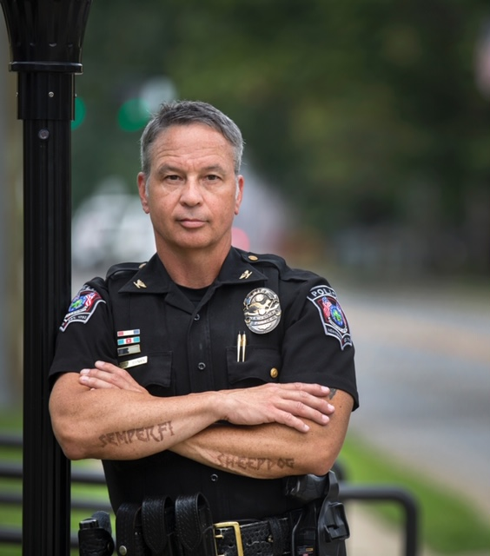
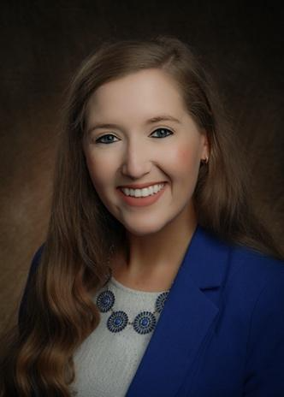
Chief Tom Synan
Interdiction Committee
Village of Newtown Police Chief
Meagan Guthrie
Director
Hamilton County Office of Addiction Response
Kelly Firesheets
VP of Strategy and Partnerships
Cordata Healthcare Innovations

Slide 6
LEARNING OBJECTIVES
Gain an understanding of the multidisciplinary approach to combating fatal overdoses in hotspot neighborhoods, including the role of cross-sector planning and collaboration.
Learn how to identify and catalog services in target areas using innovative methods
Explore strategies for developing a coordinated pathway to care by maximizing outreach data and leveraging sharing mechanisms.
Discover key metrics of success in addiction response initiatives, such as overdose death reduction rates, and understand how data-driven approaches can inform and evaluate the effectiveness of interventions.

Slide 7
Hamilton county addiction response coalition

Slide 8
HC ARC
Founded by Commissioner Greg Hartman as the Hamilton County Heroin Coalition (HCHC) in 2015 as a state of emergency response to the Heroin Epidemic.
Commissioner Denise Driehaus has served as Executive Chair since joining the Board of County Commissioners in 2016.
In early 2020, we changed our name to Addiction Response Coalition to reflect the comprehensive work of the Coalition, not for a particular drug but combatting the addiction crisis itself.

Slide 10
TOTAL OVERDOSE DEATHS

Slide 12
County-wide Deflection Programming

Slide 13
How can we help you?
The Quick Response Team (QRT) is a co-responder deflection program that partners trained navigators (peers and behavioral health specialists) with law enforcement officers to provide community-based substance use, mental health, homelessness, and other needs-based services, with the immediate goal of connecting Hamilton County residents with the most appropriate care specific to their needs.

Slide 14
How does Hamilton county define deflection?
An intervention initiated by a co-responder team (law enforcement and peer navigator) to change an individual’s trajectory or divert them out of the criminal justice system and assisting them into Hamilton County’s continuum of care.

Slide 15
DEFLECTION PROGRAMMING TIMELINE
2015
First QRT in the nation launches in Colerain Township
2016
QRT launches in the City of Norwood
2017
County awarded $400,000 federal CARA grant to implement QRT
2018
Hamilton County’s county-wide QRT launched two days per week (East/West)

Slide 16
2020
County awarded $1M federal COSSAP grant to implement a full-time QRT that included proactive hotspot outreach
County awarded $433k State COSSAP grant to implement an African American Outreach Program
2021
County launches its expansion with two full-time teams
2022
County awarded $1.6M COSSAP grant to expand deflection efforts to incorporate all six deflection pathways

Slide 17
Outreach types
Reactive Outreach
Proactive Outreach
Door Knocks
Overdose follow-up three to five days post-overdose
"How can we help you?”
Referrals
Law Enforcement
Fire/EMS
Hospitals
Public Health
Hamilton County Justice Center
513 Relief Bus
African American Outreach Team
Community Outreach and Engagement Events
Hamilton County Common Pleas Drug Treatment & Recovery Court Outreach
Holistic Outreach for Priority People (HOPP)
Stigma-free Access For Everyone (SAFE) Services Van Outreach
Wellness Checks
Veterans Outreach

Slide 18
Referrals & the greater Cincinnati fusion center
Our referrals come from the Greater Cincinnati Fusion Center that was designated our overdose data repository (2015 County LE Protocol on Overdose)
An Intel analyst at the Fusion Center does an extensive workup on each person to identify: addresses, phone numbers, next of kin info, veteran status, any officer/team safety concerns

Slide 19
Services provided by the quick response team
Linkage to Care –
Direct access and referral to treatment
Peer navigators are champions for recovery by eliminating barriers and assisting them to a personalized path to recovery
Family support and counseling
Harm Reduction materials courtesy of Hamilton County Public Health
Community outreach, education, and training
Wellness Checks

Slide 20
Since our launch in April 2018...
Received 4,300+ Inbound Referrals
Conducted 8,900+ interactions
Distributed 3,500+ Harm Reduction Supplies
Conducted 570+ Community Outreach Events

Slide 21
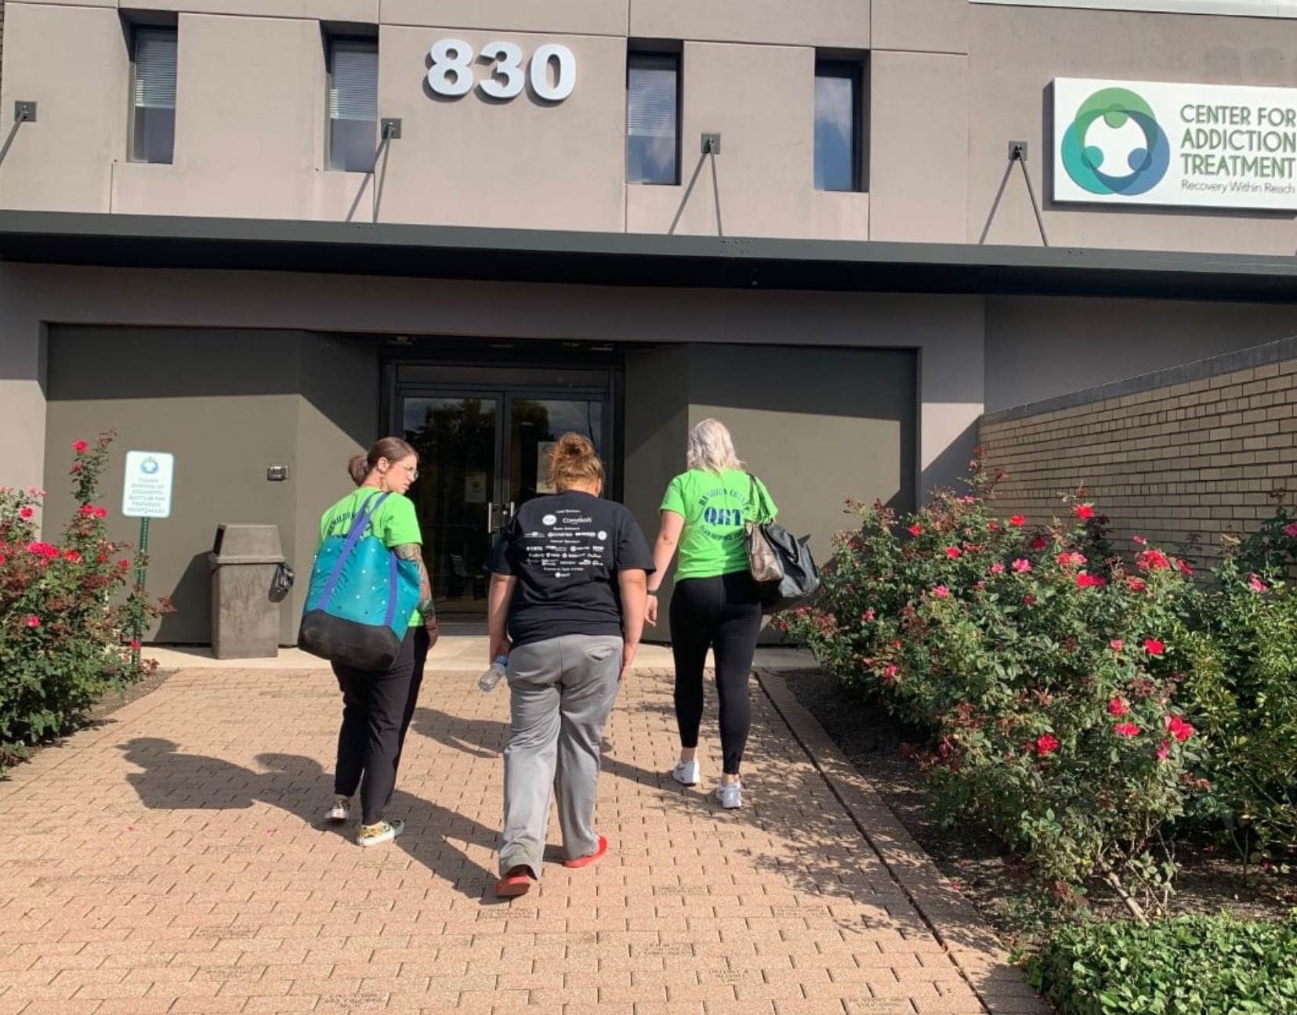
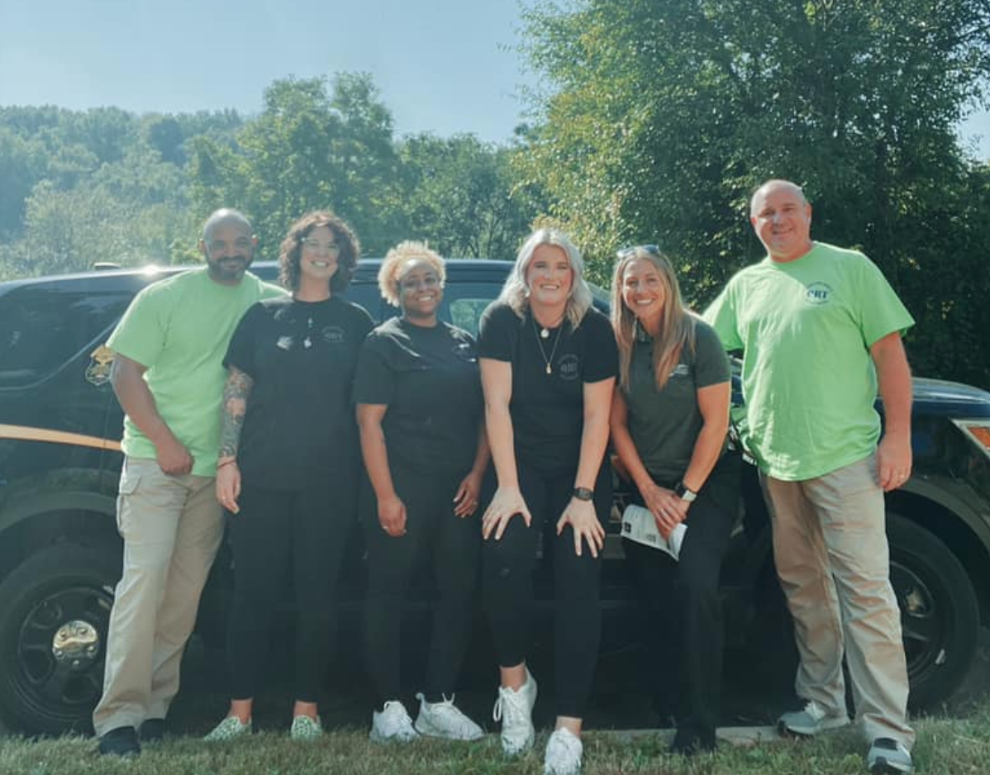
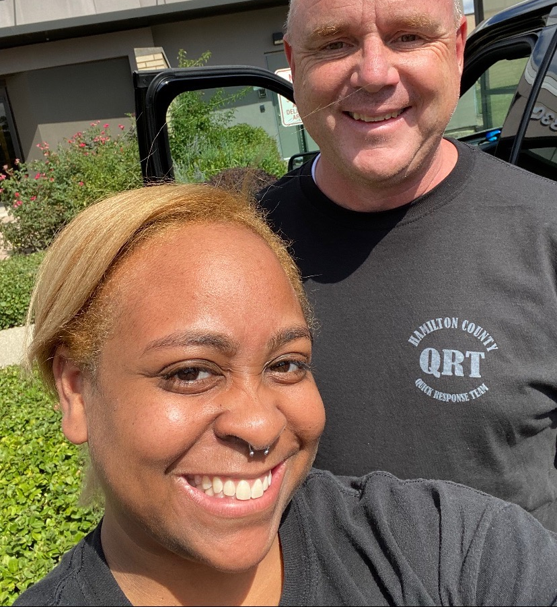
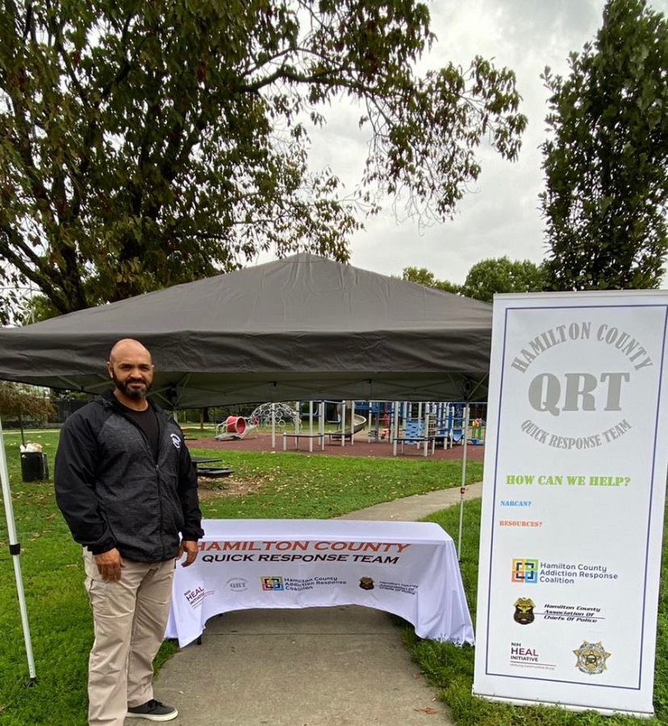

Slide 22
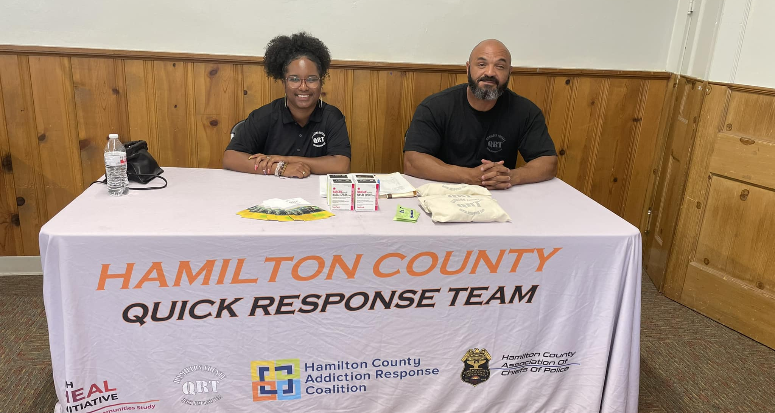
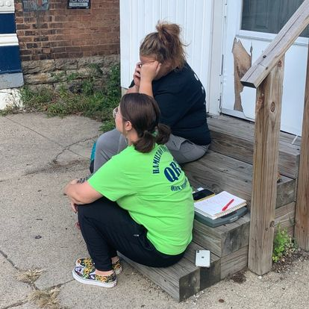
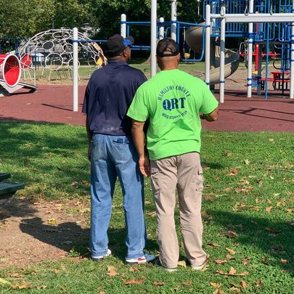
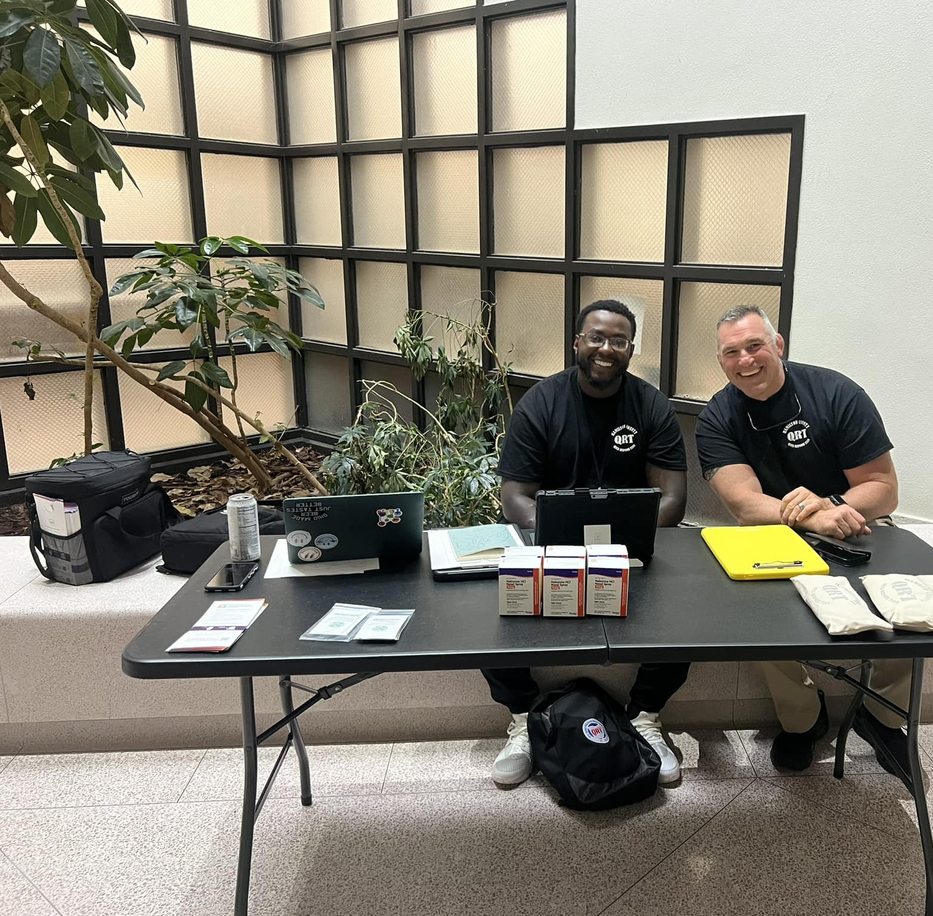

Slide 23
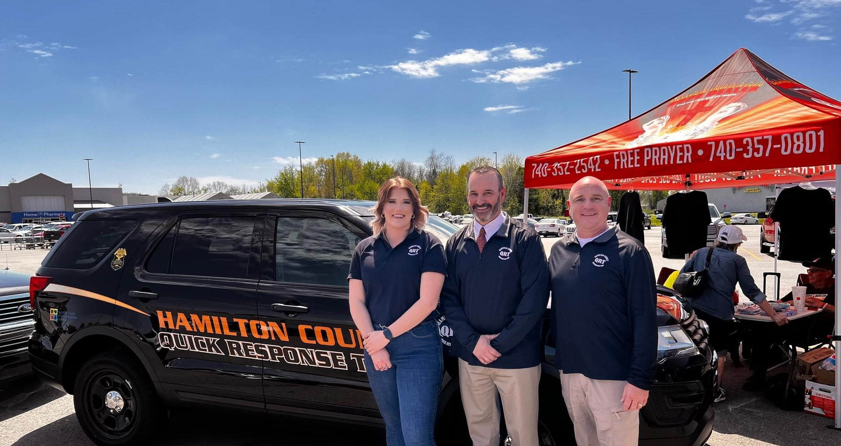
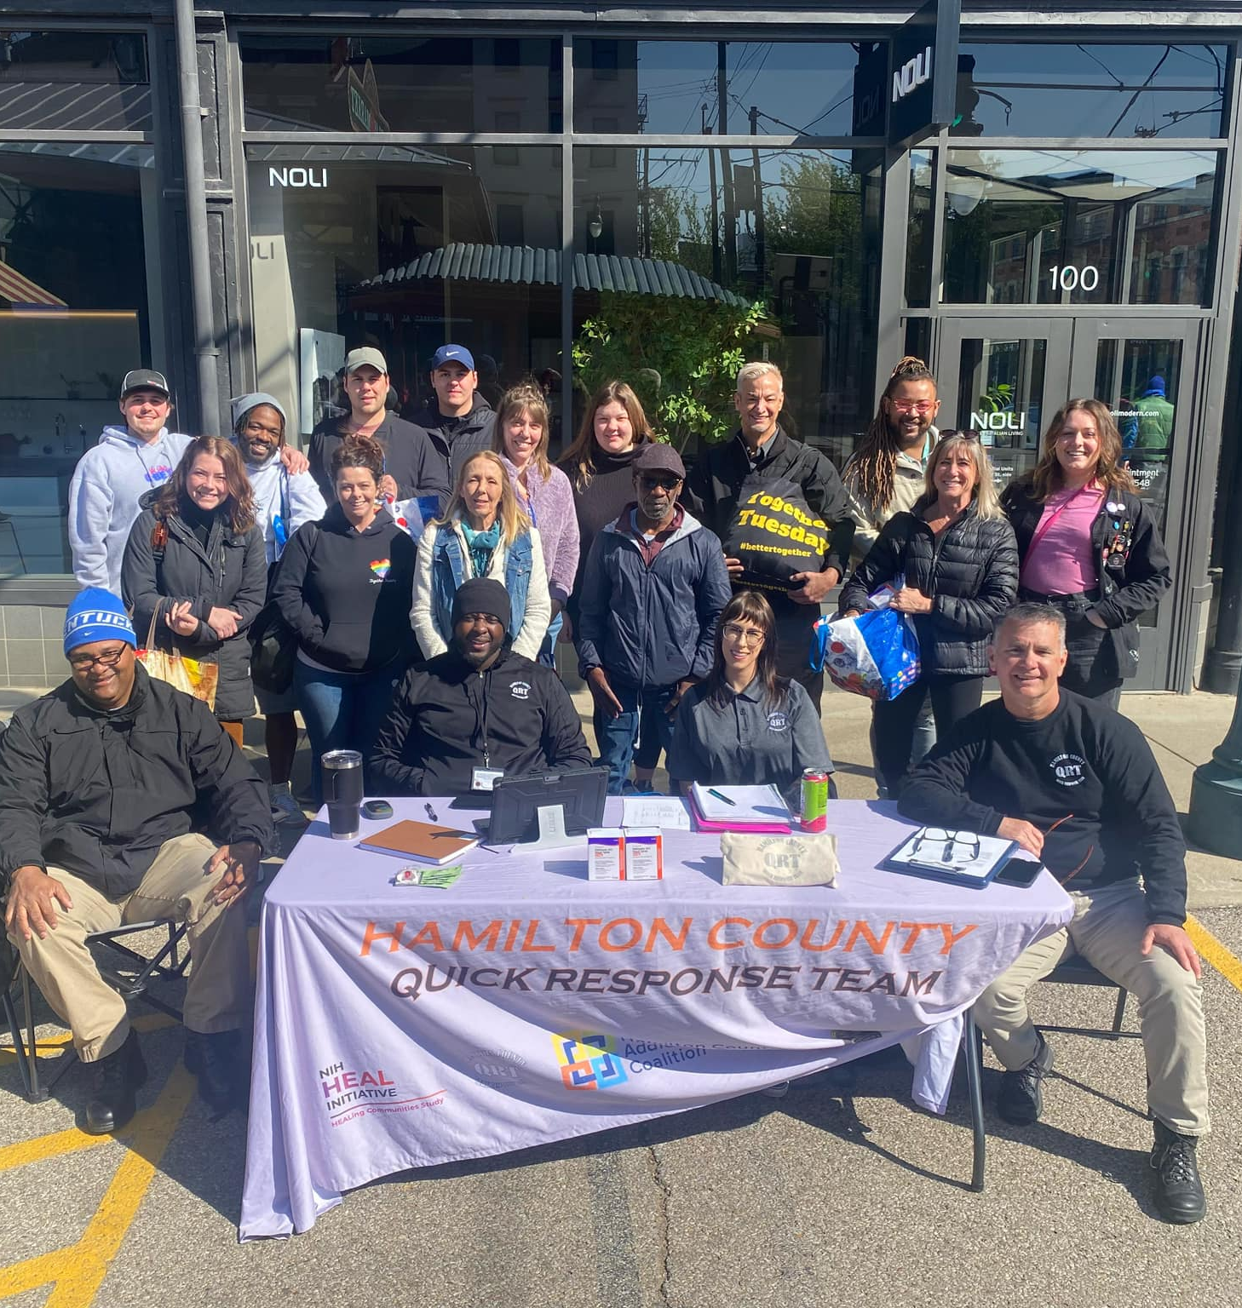
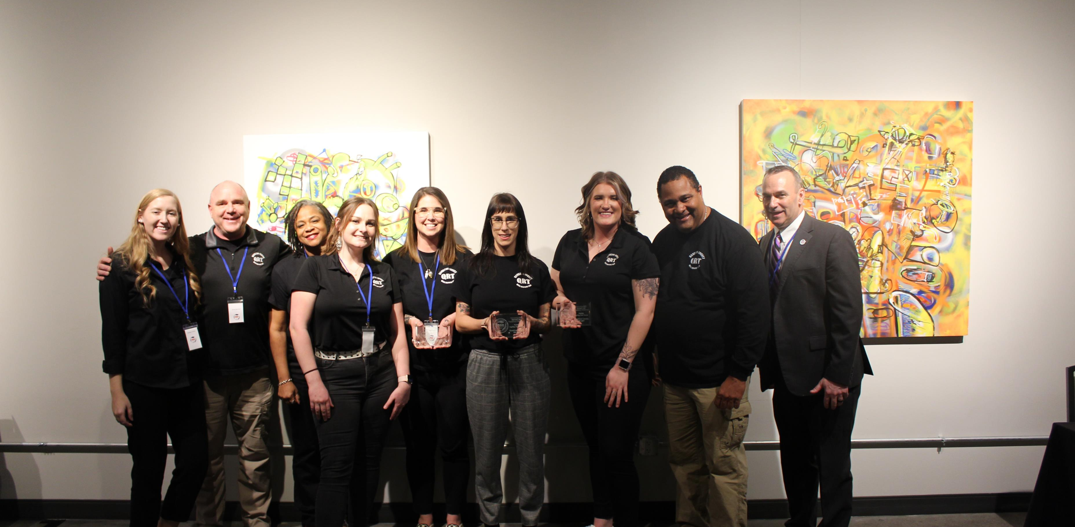

Slide 24
HOPP
Holistic outreach for PRIORITY PEople

Slide 25
HOPP PROGRAM
Partnership with Cincinnati Police District 3
Began with the 3 neighborhoods of Price Hill (East, West and Lower)
Expanded to all Police District 3
Originally referred to HOPP team for 3 or more overdoses
Since expanded now encompasses law enforcement and community-based referrals for subject in need of intense case management
Our Navigator has worked with 72 participants to date and manages an active caseload of 30-40 individuals at varying levels of need / intensity

Slide 26
Program overview
 | Wave 1 | Wave 2 | Wave 3 | Wave 4 | TOTAL
Start Date | 11/1/2021 | 6/15/2022 | 1/15/2023 | 4/1/2023 | 7/1/2023
Total Participants | 14 | 9 | 17 | 32 | TBD
Pre-Project ODs | 30 | 8 | 20 | 58 | 116
ODs After Wave Start Date | 14 | 19 | 0 | 1 | 34
TOTAL | 44 | 27 | 20 | 59 | 152
% Change | -53.33 | 137.5 | -100 | -98.27 | -70.69

Slide 27
outcomes
27% - Unable to Contact
20% - Engaging
18% - Closed – Ineligible, Deceased, Out of County, Declined
13% - In Recovery
11% - In Treatment
11% - Incarcerated

Slide 28
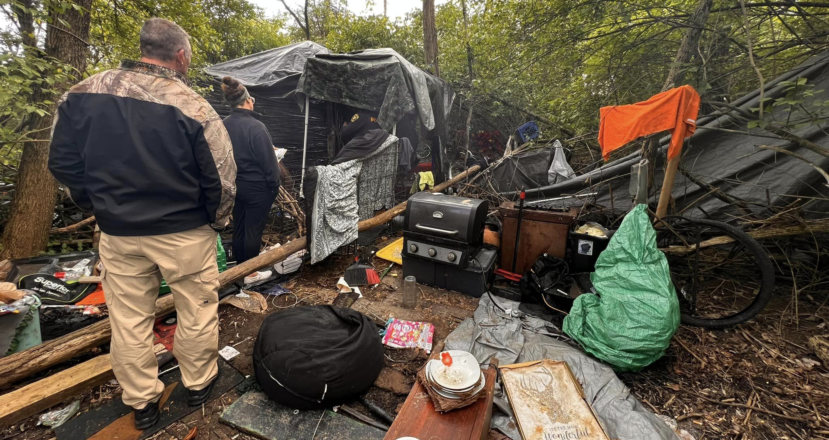
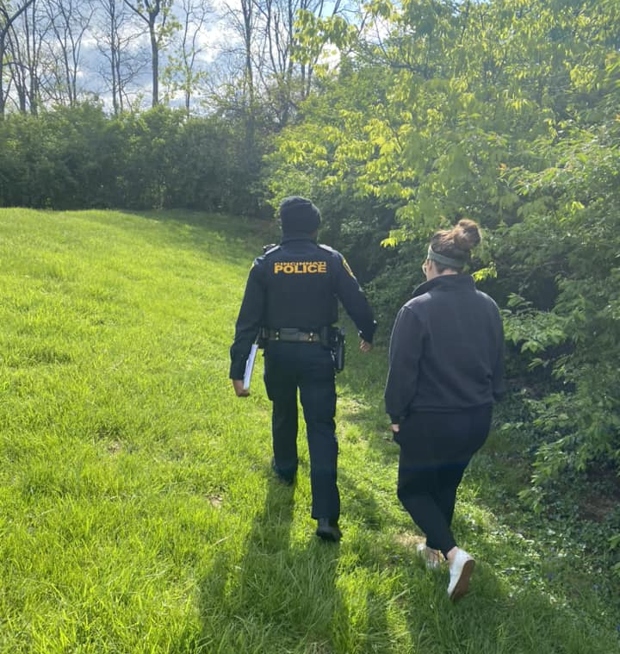
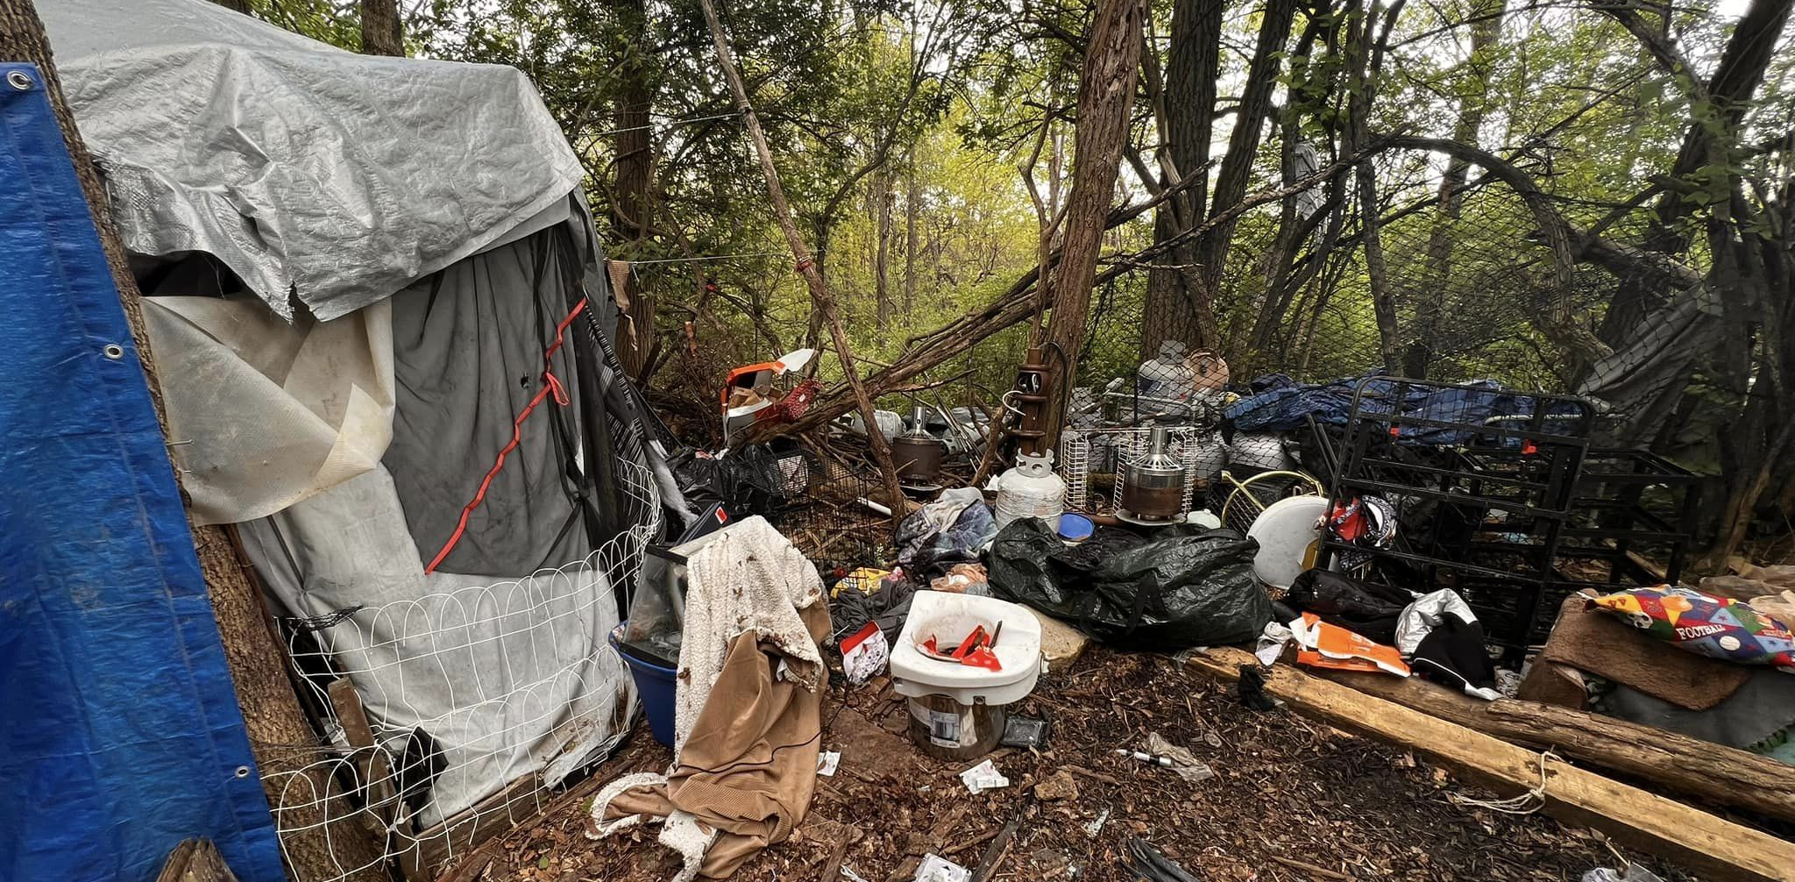

Slide 29
Data-informed expansion
Kelly firesheets

Slide 30
Data-Informed Expansion
QRT WORKFLOW
Workflow support for Quick Response Team(s)
RESEARCH REGISTRY
Real-time, deidentified data available for research and evaluation support
SPECIALTY COURTS
Workflow support for Drug Courts
STREAMLINED REFERRALS
Automated referrals to outreach and deflection
OUTREACH AND HARM REDUCTION
Workflow support for harm reduction and outreach activities

Slide 31
Secure, Person-centered data management
Legal and
Criminal Justice
Law Enforcement
Social Supports and Services
Housing
Addiction Treatment
Peer Recovery Supports
Health and Healthcare
Emergency Departments
County Jail
Reentry Services
Primary Care
Harm Reduction Services
EMS Encounters
Traditional Treatment
Stabilization/Detox Centers
Transportation
Employment
Child Welfare
Courts and Specialty Dockets

Slide 32
Key takeaways
The strategic and collaborative efforts of the Hamilton County Addiction Response Coalition (HC ARC) have contributed to a significant decrease of 24% in overdose deaths since 2017, showcasing the effectiveness of their deflection programming.
The co-responder pilot project launched by Hamilton County in 2021 has successfully targeted high-risk individuals responsible for a significant portion of overdose calls in a specific neighborhood. The program's emphasis on triage, assessment, and connection to appropriate services, along with intensive follow-up support, has expanded to serve 72 participants, highlighting the importance of comprehensive and continuous care.
The presentation highlights the innovative approach of identifying and cataloging services in target areas and creating a coordinated pathway to care by leveraging outreach data sharing mechanisms. This data-driven approach allows for informed decision-making and evaluation of the initiative's success, including key metrics such as overdose death reduction rates, providing valuable insights for future addiction response efforts.

Slide 33
Thank you!
CONTACT INFORMATION
Meagan Guthrie
Director, Hamilton County Office of Addiction Response
Meagan.Guthrie@Hamilton-co.org
Col. Thomas W. Synan
Chief of Police, Newtown Police Department
tsynan@villageofnewtown.com
Kelly Firesheets, PsyD
Vice President of Strategy and Partnerships, Cordata
kelly.firesheets@cordatahealth.com

Slide 34
Questions?

Slide 35
Join us at Putting Care at the Center 2023 Nov. 1-3, 2023 in Boston, MA
Sponsorship opportunities
Interprofessional CEUs
Discounts
Virtual access for those unable to travel
Learn more → camdenhealth.org/annual-conference | #CenteringCare23

Slide 36
We want your feedback! An evaluation survey will be sent out after this webinar

