Slide 1
Hi-Touch Healthcare
Notes:
Display as participants enter and explain that this training was developed and created based on industry and educator input in conjunction with the Health Workforce Initiative Statewide Advisory Committee, California Community Colleges Chancellor’s Office, Workforce and Economic Development Program. This is just one soft skills module of the comprehensive training package: “Hi-Touch Healthcare: The Critical 6 Soft Skills.”

Slide 2
Self-reflection

Slide 3
WHAT TO EXPECT IN THIS PRESENTATION
Overview of Self-Reflection
Importance of Self-Reflection
Personal Self-Reflection in Healthcare
Internal and External Factors
Self-Reflection Depth Perception Activity
What, So What, Now What? Activity
Notes:
Quickly preview the session.

Slide 4
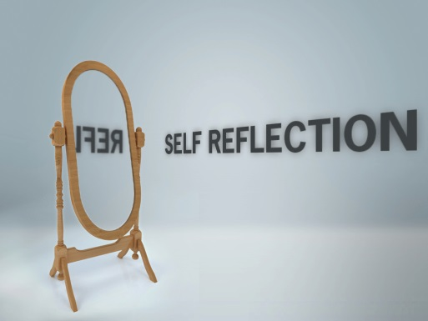
Self Reflection
“The real man smiles in trouble, gathers strength from distress, and grows brave by reflection.”
-Thomas Paine
http://www.brainyquote.com/quotes/quotes/t/thomaspain386293.html?src=t_reflection

Slide 5
Definitions of Self-Reflection
“An intentional, active progression of learning” (John Dewey, Philosopher of Education)
“Careful thought, especially the process of reconsidering previous actions, events, or decisions” (Encarta English Dictionary, 2016)
“Careful thought about your own behavior and beliefs” (Miriam-Webster Dictionary, 2016)
Notes:
(Animated slide)
Read the definitions from various sources on self-reflection.
Discuss that reflection is really something that we do in hindsight. We come across a situation that affects us, or makes us think twice about. We think about the situation, and how we could have handled it differently.
Self-reflection is something we “should do,” but we often don’t.
(Ask the participants why they think we often don’t take the time to self-reflect.) Some possible reasons might be “It might cause a conflict with another individual,” “I may not want to admit that I didn’t choose the best course of action in a specific situation,” or “It takes too much time to think about it.”

Slide 6
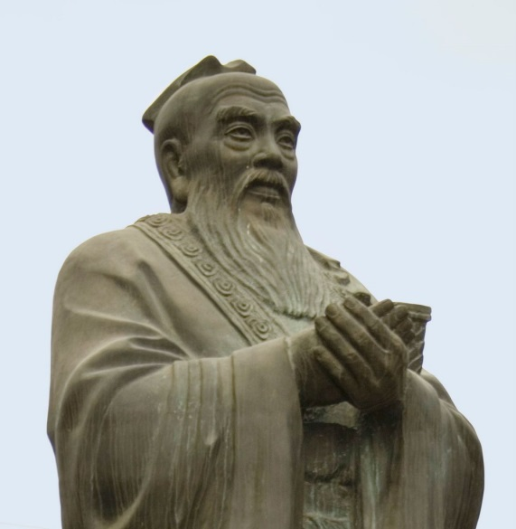
Confucius Said…
“By three methods may we learn wisdom: first by reflection, which is the noblest; second by imitation, which is the easiest; and third, by experience, which is the most bitter.”
Notes:
Read the quote by Confucius. The ability to self-reflect is considered a noble behavior, and only through reflection can we learn, grow, and progress in both our personal and professional lives.

Slide 7
Self-Reflection in Healthcare
“Reflection is a way by which one takes personal responsibility for one’s actions and then develops strategies for sustainable change.”
--(Boomer & McCormick, 2010)
Notes:
Read the definition.

Slide 8
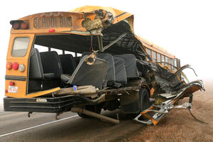
The Day in the Life of a Healthcare Worker
You work as a unit secretary in a large mid-city Trauma Center. A school bus has crashed and 21 children, aged 6-12, have been injured in the accident. 14 of them will be arriving in your department in approximately 20 minutes. This is what you see:
Notes:
Read the following scenario: You are a 33-year-old woman with three children, ages 6, 9, and 11. You begin emptying rooms in order to receive patients. As appropriate, you place paperwork and equipment in each room. You begin calling in extra staff who begin to arrive as patients are beginning to be brought in. When the children arrive by ambulance and private vehicles, you send them to the appropriate rooms, each with one nurse (or more if necessary based on the child’s injuries). You hold it together for about 10 minutes as more children continue to arrive, some in extremely critical condition. One child is brought in, and the paramedics are performing CPR. The child is 6 years old, the same age as your youngest.
You begin crying uncontrollably and rush to the child’s side. You are trying to help but you obstruct the gurney, and the paramedics cannot move the child into the Trauma Room. You cannot seem to help yourself--you cannot leave the child’s side. The charge nurse (Tom) must intervene and gently pulls you away from the child’s side. Tom looks at you and says “You need to get control; we need you now.” You regain control and try to finish your job, which you do.
After the shift is over, the staff are called together for a debriefing. You just don’t feel like you can think about the day any longer and you choose to go home instead.

Slide 9
What Went Wrong?
What could the unit secretary have done to better prepare herself for the situation?
What should she have done in the situation instead of what she did?
Do you think debriefing is important after a situation like this? Why/not?
Would self-reflection help? Why/not?
Notes:
(Animated slide)
The story seems a little extreme, but sometimes situations occur in healthcare that we are not prepared for.
Ask the questions. Allow for open discussion about de-briefing and whether individuals feel it is beneficial or not. De-briefing is a form of self-reflection. How did I do? Could I have done better? What could I have done to make things better? How well did we work as a team? How could we improve our practice?

Slide 10
Activity #1 Personal Self-Reflection
Notes:
(See detailed procedures on page 5 of the Trainer Manual that accompanies this PowerPoint.)
Goal: This activity provides an opportunity for participants to reflect on a recent incident that occurred at work and at home. The goal is to evaluate whether or not the act of self-reflection facilitated learning and prompted change of perspective and/or the development of strategies to guide more productive decisions in the future.
Materials Needed:
One 8 1/2 X 11 inch piece of paper and a pen/pencil for each participant.
Procedures:
Hand a piece of paper and a pen/pencil to each participant.
Have participants mark the paper into four equal parts (two upper boxes and two lower boxes).
In the upper left-hand box write "Incident at work and the way I handled it."
In the upper right-hand box write "Incident at home and the way I handled it."
Give participants 5-7 minutes to honestly describe each incident, including details about both the external (environmental) factors and the internal (emotional/psychological) factors that influenced how the person handled the situation.
On the lower left-hand box write "Incident at work and the way I could have handled it."
On the lower right-hand box write "Incident at home and the way I could have handled it."
Divide groups into pairs. Give participants the option of working independently if they are reluctant to share the details of their incidents.
Allow the participants 10-15 minutes to discuss the incidents. For each incident, participants should try to list at least 7-10 alternatives. These alternatives could be change tone of voice, take a deep breath, ask clarifying questions, etc.
When everyone has completed the activity, invite discussion on the following points:
After reflecting on the incident, what kinds of things would you change if the incident were to happen again?
Would it be possible for you do actually do those things?
Do you think the outcome may be better if you tried those things?
Why?

Slide 11
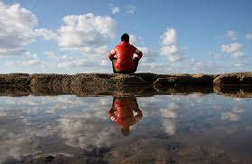
Environmental Scanning (Leung & Ratnapalan, 2011)
“A method by which an individual examines the context of their surrounding or situation, looking at both internal and external factors.”
Notes:
The authors explain that self-reflection is really the cornerstone of adult educational principles. This structured approach to reflection is a method they describe as environmental scanning.
Read definition of environmental scanning.

Slide 12
Internal Factors
Individual knowledge and skill level about the situation
Attitude toward the task being performed
Does the individual feel s/he has the proper approach to certain situations?
Ask yourself “Was I being professional?” “Did I react the way I should have?”
Notes:
(Animated slide)
Read the factors that can affect how an individual reacts to a certain situation.
Individual knowledge level – do I really know about this kind of a patient? Have I been trained to do this task?
Attitude towards task – do I really want to clean the room of a patient who has body odor?
Do they have the proper approach? – did I talk to the patient and their family appropriately?
Ask yourself these questions after an interaction with a patient or a family.

Slide 13
External Factors
How does my knowledge compare to my colleagues?
Do I know the latest policy regarding specific situations?
Am I familiar with the department I am in?
Notes:
(Animated slide)
If your knowledge does not compare, learn from others. If your knowledge is more than others, teach them!
Make sure you know your current policies within the facility.
Be familiar; if you aren’t, ask questions or do research.

Slide 14
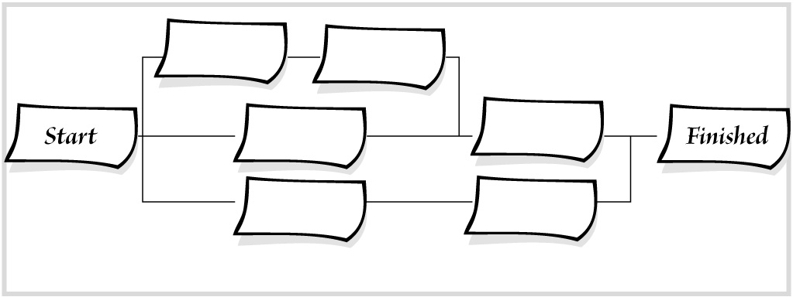
Reflect and Develop an Action Plan (Thorpe & Barsky, 2001)
First, reflect on situations that you experience.
Second, develop an awareness of areas for growth.
Third, critically analyze the situation.
Fourth, develop an action plan.
Notes:
Reflect – what occurred that bothered you? Or what do you wish had happened differently?
Awareness – what could have changed to improve the situation?
Analyze – what was problematic about the situation? Could preventative measures can be taken?
Action Plan – What strategies can be developed to prepare for a similar situation?

Slide 15
Activity #2 Self-Reflection Depth Perception
Notes:
(See detailed procedures on page 7 of the Trainer Manual that accompanies this PowerPoint.)
Goal: This activity provides an opportunity for participants to discover ways to manage barriers to achieving personal goals
Materials Needed:
One 8 1/2 X 11 inch piece of paper and a pen/pencil for each participant
Procedures:
Hand a piece of paper and a pen/pencil out to each participant.
At the top of the paper write down a major goal (either personal or professional) that you would like to achieve in the next five years.
At the top of the page write "The biggest obstacle(s) I see right now in my life that prevents me from achieving my goal is(are)…"
Have participants ask themselves the following questions:
Is the obstacle within my control? Yes? Go the next question. No? Redefine the biggest obstacle into something that can be controlled.
What are concrete steps that could help decrease and/or manage this barrier:
in the next couple of weeks?
in the next couple of months?
in the next year or so?
Develop an action plan: What is a reasonable time line with specific strategies for overcoming this obstacle?
Report out: After participants have completed this exercise, invite discussion about what they wrote down. Some may not want to share due to the personal nature of this exercise. Encourage the participants to take this paper home, read it frequently and re-evaluate if you are closer to reaching those goals.
Pledge: conclude the activity by asking participants to publically make a pledge to do one specific thing within a specific time frame.

Slide 16
Emancipatory Practice Development (Filmalter & Heyns, 2015)
In order to make sustainable change and positive outcomes, self-reflection involves the development of emancipatory practice.
This practice focuses on improving outcomes and self-understanding.
Notes:
Read slide.

Slide 17
Three Phases of Emancipatory Practice
Enlightenment – based on reflection, healthcare workers are made aware of changes that need to be made.
Empowerment – they gain information that enables them to act on the identified changes.
Emancipation – achieved when employees become empowered and enlightened to take action in order to change practice.
Notes:
Explain that employees need to be taught how to use self-reflection to make targeted changes. These steps are an easy way for individuals to learn to understand what needs to change and then to make the changes happen.

Slide 18
Activity #3 What? So What? Now What?
Notes:
(See detailed procedures on page 8 of the Trainer Manual that accompanies this PowerPoint.)
Goal: This activity provides an opportunity for participants to discover ways to manage barriers to achieving personal goals.
Materials Needed:
“What, So What, Now What?” worksheet (on page 10 of the Trainer Manual) for each participant
A pen/pencil for each participant
(Note to Trainer: if time is limited, this activity can simply be changed to an individual activity where each participant fills out his/her own worksheet then reports out as desired.)
Procedures:
Distribute a copy of the “What, So What, Now What?” Worksheet and a pen or pencil to each participant.
Have participants think of an incident that happened at work that they thought could have been handled in a better way. Have them complete the What? portion of the worksheet.
Divide participants into small groups of two or three.
Focus Groups: Explain that there will be three (or two depending on group size) rounds of this activity. For each round, one person will act as the presenter while the rest of the group helps guide the “What? So What? Now What?” process to help the presenter reflect on his/her experience. The presenter will use the worksheet to take notes during the brainstorm. Once the round is complete, a new presenter will go through the process.
What? So What? Now What? Process:
What? – the presenter will describe what happened, what s/he saw, what s/he felt, and the interactions s/he saw or had.
So What? – The group will ask the presenter questions to encourage self-reflection. The group will also offer observations and suggestions to expand the presenter’s perspective on his/her own experience. Some questions include:
Did you make a difference?
Why or why not?
What impact did you have?
I noticed that you said . . . What if . . . .
Now What? – Again, the group should provide support and encouragement for self-reflection. At the same time, the group should try to expand the presenter’s perspective by offering other alternatives.
Questions include:
What more needs to be done? What will you do now? Did this change how you will respond in the future?
Focus Group Round 1: Announce that Round 1 is about to begin and that the group must decide who will be the first presenter. Give groups 5-7 minutes to complete the process. To make sure all three steps are completed, give time warnings at half way and when 1 minute is left.
Focus Group Round 2: Repeat the process with a new presenter.
Focus Group Round 3 (if needed): Conclude the process with the final presenter.
If needed, provide a few minutes for participants to complete their worksheet if the process group process felt rushed.

Slide 19
Thank you!
Questions?
Comments?

